Slide 1

Simon Karg
simonkarg@mgmt.au.dk
PhD Fellow at the Department of Management
Research in Moral Psychology and Behavioural Economics

Slide 2
Turning the Blind Eye Dynamics Of Leadership and Team behaviour in Ethical Decision making

Slide 3
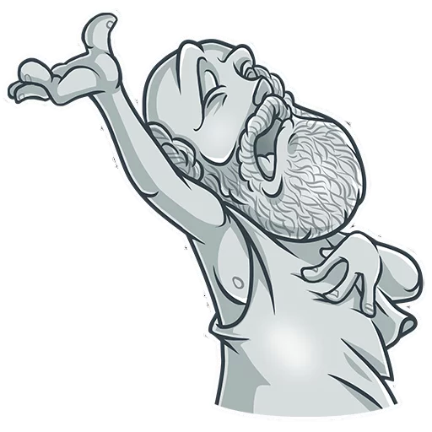
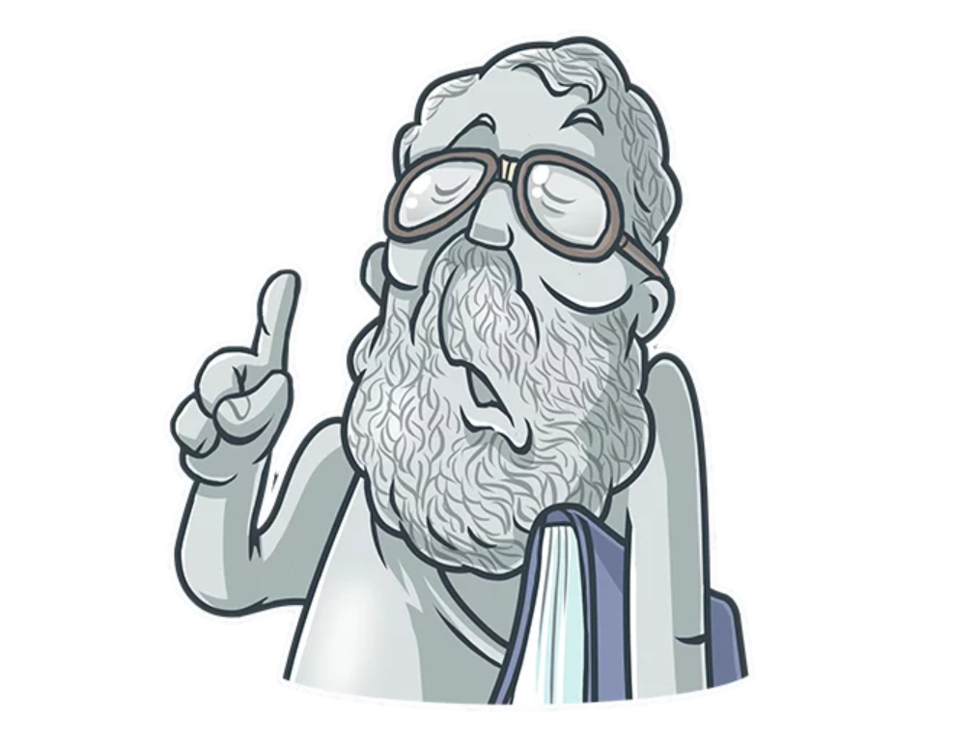
The Role of Leaders in moral behavior Contrasting positions
The leader acts as a role model
Leader behavior is a product of the environment

Slide 4
When do leaders turn the blind eye?

Slide 5
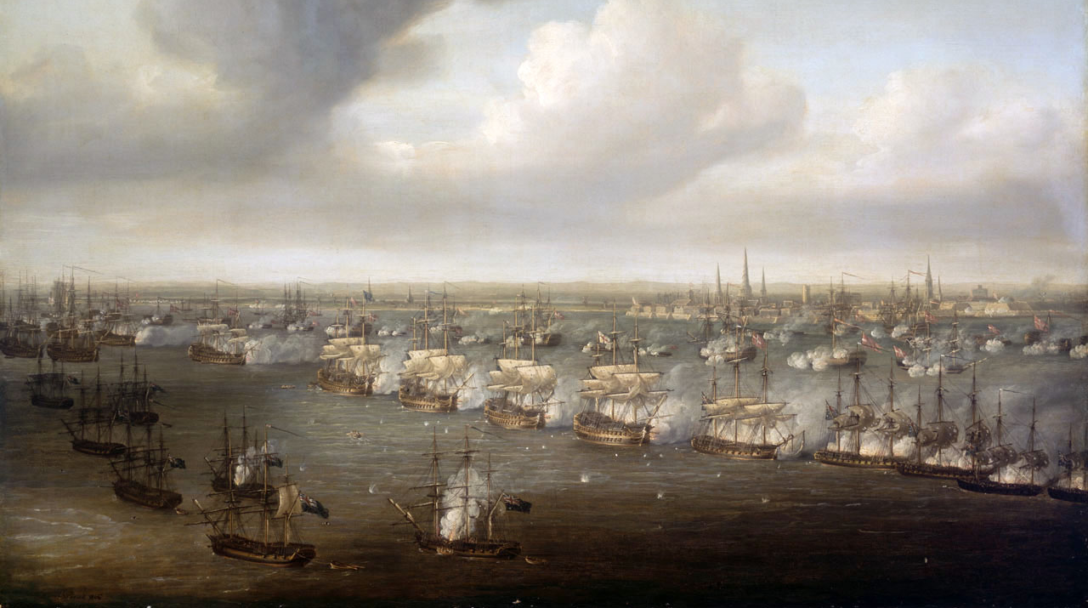
Notes:
During the Battle of Copenhagen in 1801 the cautious Admiral Sir Hyde Parker, in overall command of the British forces, sent a signal to Nelson's forces ordering them to discontinue the action. Naval orders were transmitted via a system of signal flags at that time.
When this order was brought to the more aggressive Nelson's attention, he lifted his telescope up to his blind eye, saying, "I have a right to be blind sometimes. I really do not see the signal," and most of his forces continued to press home the attack. The frigates supporting the line-of-battle ships did break off, in one case suffering severe losses in the retreat.

Slide 6
The Corruption Leadership Game
Team
Leader
Decision
Outcome
True
Rely
False
Verify
True
False

Slide 7
Factors influencing Dynamics
Team
Leader
Decision
Outcome
Signalling
True
Rely
False
Verify
True
False

Slide 8
Factors influencing Dynamics
Team
Leader
Leader
Decision
Outcome
Character Perceptions
True
Rely
False
Verify
True
False

Slide 9
Factors influencing Dynamics
Team
Leader
Decision
Outcome
Cohesion
True
Rely
False
Verify
True
False

Slide 10
Hypotheses
Moral Character
A participant’s own moral character (as measured by the moral identity questionnaire (Aquino & Reed, 2002)) will positively influence honesty
participants higher in moral identity symbolization and internalization will show less cheating / increased checking
A participant’s risk-taking propensity will be positively associated with player cheating (leader checking)
participants who are more likely to engage in risk taking (as measured by the DOSPERT, financial risk-taking scale (Blais & Weber, 2006)) are also more likely to cheat (less likely to check).
Other group members’ behavior will affect cheating
higher cheating by team members, or unchecked cheating from the team leader, will increase a participant’s cheating.

Slide 11
Hyotheses (cont)
Group Trust
Team cheating in the first stage will be negatively associated with intra group trust
that more cheating will lead to lower contributions in the PGG.
Leader checking will be negatively associated with intra group trust
more leader checking will lead to lower contributions in the PGG.
We expect an interaction between leader checking and team cheating
the negative effect of leader checking on trust will be stronger when team cheating is high.

Slide 12


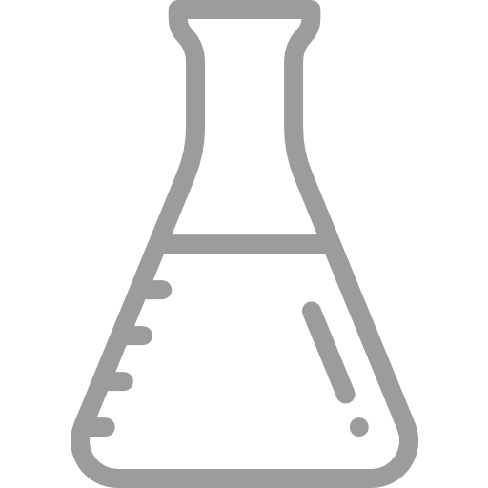
Three Methodological Approaches
Simulation
Online Studies
Lab

Slide 13
Simulations

Slide 14
Weisel & Shalvi (2015)

Slide 15
Levine, BittErly, Cohen, Schweitzer

